Slide 1

An Optimization Technique for the Detection of Safety Attributes Using Roadside Video Data
Presented by:
Pubudu Sanjeewani,
Centre for Intelligent Systems,
School of Engineering and Technology,
Central Queensland University,
Brisbane, Australia
p.thihagodagamage@cqu.edu.au

Slide 2
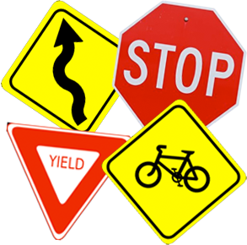



Introduction
Road safety attributes detection is important.
Different combinations of parameters such as image sizes, architectures, iterations, and learning algorithms result in different prediction accuracy.
The best model parameters for one dataset are not the best across all datasets.
Finding the best parameter combination manually is a difficult task.

Slide 3




Continued..
Evolutionary Algorithms (EAs) are well known to solve optimization problems.
Genetic Algorithms (GAs) have been widely used in literature for features or network parameter selection and have shown promising results.
There exists a gap in literature to find an automatic technique to get optimal parameters for training of deep learning-based networks.
Therefore, the aim of our research is to automatically find suitable parameters to train Fully Convolutional Neural Network (FCN) to detect road safety attributes.

Slide 4


Continued..
The parameters include,
image sizes: 32, 64, 256, 400, and 800;
number of epochs: 1,000, 2,000, 5,000, 15,000, 20,000, 30,000, and 40,000;
learning algorithms: Adam, RMSProp, and Adadelta;
number of layers: 2, 4, 6, 8, 10, 18, and 24;
activation functions: ReLU, and Sigmoid; and
pooling types: average and max.
Manually choosing the best value of these parameters is time consuming and inefficient.

Slide 5



Novel Contribution
A design of a novel technique based on EA and FCN to find a suitable set of parameters for safety attribute detection.
Design an FCN model with a set of optimized parameters for improved road safety attribute detection.
A comparative analysis of results obtained by the proposed optimized technique and non-optimized techniques for road safety attributes detection.

Slide 6
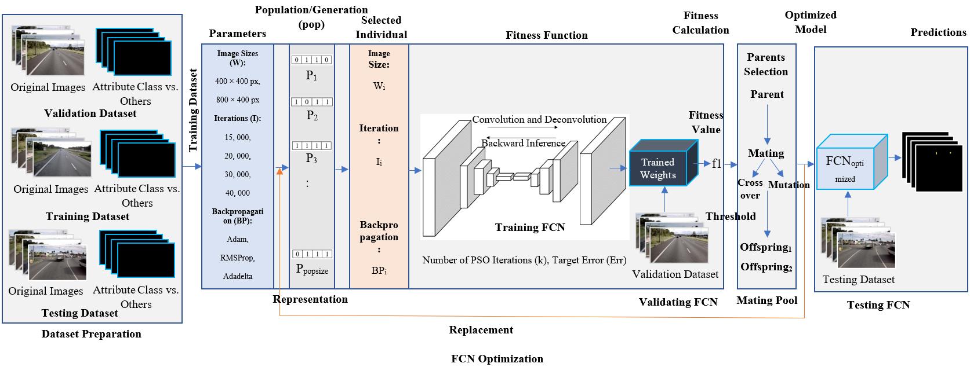
Proposed Technique
Figure 1: Proposed Technique.

Slide 7
Flowchart to Optimize and Evaluate FCN Using EA
Parameters
Image Size, Iteration, Backpropagation
Represent Each Individual
Individual (Chromosome (Set of Genes (Allele, Locus)))
Initialize Population
Population (Size: = Number of solutions/individuals)
P1, P2, P3, ……, Pn
Kill Individuals
No
Fitness Evaluation
Training FCN for an Attribute
Validating FCN
Calculating the Accuracy (Fitness Value (f))
Parents Selection
Mutation
Offspring
Crossover
Mating Pool
If fp1 > Threshold
Yes
Mutation
Selection
FCN with Highest Accuracy (Optimized FCN)
Calculate Classification Accuracy, Error Values and F1 Score
Prediction Results for Visual Comparison
If Iteration >=Max Iteration OR f >Threshold
Test Images
Yes
No

Slide 8
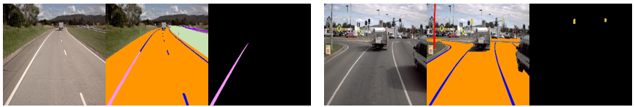
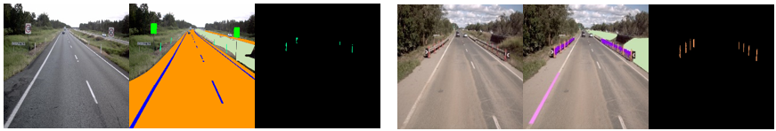
Visual Results
Rumble Strip
Signal Light
Guidepost
Flexipost

Slide 9
Experiments and Results
Table 1: Individual Solutions Selected by EA and the Corresponding Classification Accuracies Obtained by the Proposed Technique for Signal Light Attribute.
Generation | Individual Solutions Selected [Image Size, Iteration, Learning Algorithm] | Attribute Wise Accuracy (%)
1 | [400 × 400 pixels, 40, 000, Adadelta] | 27.27
2 | [800 × 800 pixels, 30, 000, Adadelta] | 38.47
3 | [800 × 800 pixels, 40, 000, Adadelta] | 46.16
4 | [400 × 400 pixels, 20, 000, Adam] | 54.53
5 | [800 × 800 pixels, 40, 000, RMSProp] | 84.63
6 | [800 × 800 pixels, 15, 000, Adam] | 93.31
7 | [800 × 800 pixels, 15, 000, RMSProp] | 92.31
8 | [800 × 800 pixels, 15, 000, RMSProp] | 92.31
: | : | :
Best | [400 × 400 pixels, 40, 000, RMSProp] | 100

Slide 10

Comparative Analysis
Table 2: The Best Classification Accuracies Obtained by FCN Using EA for Different Sets of Parameters [Image Size, Iteration, Backpropagation Algorithm]
Attribute | Attribute Wise Accuracy (%) | Loss (%) | Pixel Wise Accuracy (%) | Loss (%)
Rumble Strip | 100.00 | 0.00 | 73.00 | 27.00
Flexipost | 85.59 | 14.41 | 69.00 | 31.00
Guidepost | 92.19 | 7.81 | 65.00 | 35.00
Table 3: Comparative Analysis of Results
Attribute | Accuracy (%)
 | Proposed Technique | Proposed Technique without Optimization
Signal Light | 100.00 | 88.88
Rumble Strip | 100.00 | 74.00
Flexipost | 85.59 | 90.94
Guidepost | 92.19 | 92.31

Slide 11






Conclusion and Future Work
The proposed technique,
is capable of automatically finding suitable network parameters for detection of safety attributes.
achieved 85-100% accuracy for various attributes using a set of optimized parameters.
is better than the proposed technique without optimization in terms of accuracy.
can be used to automatically design an FCN for safety attributes.
was initially used to optimize a limited number of roadside safety attributes.
will be extended to optimize FCN for all roadside safety attributes and more experiments with all parameters will be conducted so that we can fully develop an automated system for road rating.

Slide 12



Slide 13


